Slide 1

Supply Management
Supply Management Analytics: Supplier Pricing in Caterpillar Supply Chain
Group 4:
Mohammad Sharif Azimy
Antonios Stefanakis
Chinelo Lydia Nweke
Takal Ebrahimkhel

Slide 2


2 Min
Introduction
2 Min
Business Case
16 Min
ML Algorithms
3 Min
Business Impact (Benefits, Cost, and Outcomes)
2 Min
Risks, Recommendations, Next Steps, Lessons Learned

Slide 3
Introduction

Slide 4

Forecasting Caterpillar Tube Assembly Prices
Why this business case matters before modeling starts.
Industrial equipment production depends on purchased components and supplier quotations.
Quote uncertainty can slow procurement decisions and weaken negotiation preparation.
Predictive analytics supports decisions by estimating likely outcomes before final supplier commitments.
For this project, the business output is a quote benchmark; the technical output is a trained cost-prediction pipeline.
Business importance: better price visibility supports faster, more evidence-based procurement decisions.
Source: Waller & Fawcett (2013); Shmueli & Koppius (2011); Liu (2022)
Group

Slide 5
Project Domain / Scope and Focus
- Procurement & Supplier Pricing
- Manufacturing + Supply Chain / Procurement Quoting
What happens in reality:
Multiple suppliers provide quotes for tube assemblies (custom manufactured parts).
Quote price depends on: supplier, date, requested quantity, commercial constraints, and tube design + components.
- Combine tube assembly, supplier quote, bill of materials, and component data.
- Focus on predicting quoted price, not manufacturing design.
- Handle both bracket pricing and minimum-order pricing.
Group

Slide 6
Project objectives
Team roles
- Forecast supplier quote price at the assembly level.
- Identify the most important cost drivers in the quote data.
- Support faster, better-informed supplier negotiation.
Mohammad Sharif Azimy: Project Manager and Data Engineer
Antonios Stefanakis: Data Analyst
Chinelo Lydia Nweke: Data Engineer
Takal Ebrahimkhel: Data Scientist
Group

Slide 7
Tasks and milestones - CRISP-DM
Timeline
Business Understanding
Data Understanding
Data Preparation
Modeling
Evaluation
Deployment / Finalization
04/02 – 04/09/2026 | 04/16 – 04/30/2026 | 04/16 – 05/07/2026 | 05/07 – 06/11/2026 | 06/11 – 06/18/2026 | 06/18 – 06/25/2026
•Determine Business Objectives •Assess Situation •Determine Data Mining Goals •Produce Project Plan | •Collect Initial Data •Describe Data •Explore Data •Verify Data Quality | •Select Data •Clean Data •Construct Data •Integrate Data •Format Data Result: Preprocessed Data | •Select Modelling Techniques •Generate Test Design •Build Model •Assess Model | •Evaluate Results •Review Process •Determine Next Steps | •Plan Deployment •Plan Monitoring and Maintenance •Produce Final Report •Review Project
Milestone
05/07/2026
Milestone Presentation
06/25/2026
Final Presentation
06/24/2026
Submit PDF
Group

Slide 8
Deliverables: Business and Technical
Business deliverables
Procurement use case and business case rationale
Cost-driver interpretation and analysis for supplier quote
Recommendations on how predictions can support quote validation
Predictive models to support procurement quote validation
Technical deliverables
Cleaned and merged Final_DF dataset
Notebook code, model metrics, plots, and saved model files
Validation setup, feature importance, and reproducible code repository (on Github)
Visual analysis of pricing drivers
Evaluation result: RMSE, MAE, R2 across models
Fine tuning with hyperparameters
Source: Provost & Fawcett (2013); CRISP-DM: Chapman et al. (2000)
Group

Slide 9
Constraints
Limitations in dataset such as specification dataset which is relational table but the other table is missing.
Time constraints (semester timeline).
Less familiarity with online platforms to integrate codes produced in group, the compilation requires extensive efforts by Project Manager.
Group

Slide 10
Business Case
Understanding what drives supplier pricing is essential for reducing procurement costs and improving negotiation outcome in industrial analytics.
Group

Slide 11

Business Case: Why Predict Supplier Quotes?
The business case is important because procurement decisions are made under cost uncertainty.
Tube assemblies are custom industrial components; quote prices can vary by design, volume, supplier, and commercial rules.
Without a benchmark, procurement may overpay or spend more time validating quotes manually.
Predictive analytics can support operational decisions by estimating expected outcomes and highlighting exceptions.
The model therefore creates business value as a decision-support tool: it improves visibility, not automatic price setting.
Business output: a data-based quote benchmark for negotiation, validation, and supplier comparison.
Group
Source: Shmueli & Koppius (2011); Waller & Fawcett (2013); Liu (2022)

Slide 12

Theoretical Background: Supply Chain Analytics
Supply chain analytics links operational data to planning, risk, and cost decisions.
In our project, supply management concerns sourcing components and materials from external suppliers.
Companies operating in manufacturing sector depend heavily on the supplier network for parts procurement.
Operational coordination and analytics becomes valuable as it improves decisions such as planning, sourcing, and risk management.
In this project, supplier quotes are treated as operational data that can reveal pricing patterns.
Forecasting quote prices fits the literature view of analytics as a tool for decision support in supply chains.
Supply chain data + predictive analytics = better sourcing decisions.
Group
Sources: Liu (2022); Waller & Fawcett (2013)

Slide 13
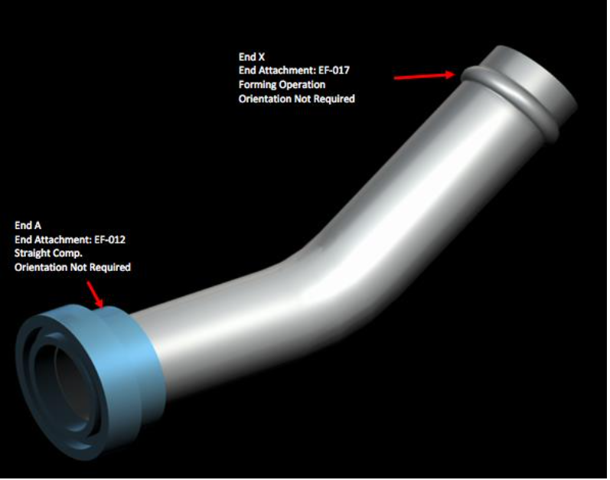
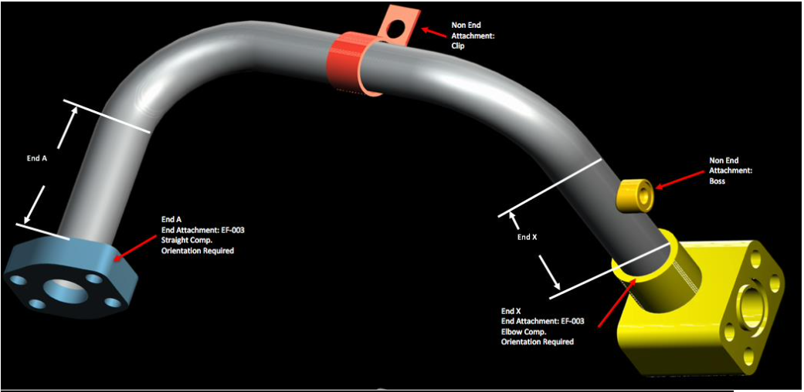
What are tube assemblies?
Multi-component industrial products used in hydraulic and pneumatic systems.
Comprises of bends, fittings, bosses, brackets, and end connections and each contribute to final assembly cost.
Each tube is custom-configured to specification, no two assemblies are priced identically, making cost estimation unreliable.
Group

Slide 14
Why Pricing Is Difficult
Pricing is nonlinear because cost depends on interacting product, supplier, and order factors.
Component mix and end forms can signal special processing, tooling, or assembly complexity
Supplier quote prices are difficult to predict because they depend on geometry, materials, components, and supplier strategy.
Quantity tiers and minimum-order rules change unit price behavior.
Supplier strategy and risk can add margins that are not visible from geometry alone.
This justifies using machine learning models that can capture interactions rather than only simple averages.
Source: Liu (2022); Provost & Fawcett (2013)
Group

Slide 15
Supplier Quote Process
Technical representation
Rows represent historical quote observations
Features represent commercial and engineering conditions
Target variable is the observed supplier quote cost
Understanding the bracket and non-bracket pricing regimes is critical because treating them as the same during modeling will introduce errors in the prediction.
The business process defines what the model predicts and how the output can be used.
Non-bracket pricing applies a fixed rate once minimum order quantity is reached.
Process Ends
Supplier receives request for assembly and quantity
05
01
04
Supplier prices based on volume, complexity, timing, and risk
Bracket pricing changes with quantity ordered, larger orders attract low unit price.
02
03
Buyer compares quotes and negotiates with suppliers
Prediction use: compare a submitted quote against the expected cost range from historical data.
Source: Shmueli & Koppius (2011); Liu (2022)
Group

Slide 16


Pricing Structure
- Full cost pricing = fixed cost + variable cost + margin
- Fixed cost: costs that do not change with quantity, such as tooling and setup. In this dataset, bracket_pricing and min_order_quantity capture whether fixed cost thresholds apply
- Variable cost: costs that scale with the tube’s physical properties. Reflected in columns such as wall, length, num_bends, and Total_weight from the bill of materials
- The profit markup added by the supplier, which varies by supplier relationship and order risk. The supplier column and annual_usage partly capture this behaviour
Group

Slide 17
Business Context and Importance
The project matters because pricing visibility affects procurement performance.
Procurement teams often need to evaluate quotes before all cost details are transparent.
A prediction benchmark supports faster screening of reasonable vs. unusual quotes.
Manufacturing companies such as Caterpillar depend on external suppliers for thousands of custom industrial components.
Each component requires a formal price quotation before procurement can proceed.
Cost-driver insights support better supplier conversations and negotiation preparation.
Literature on predictive analytics emphasizes decision support: the model should improve the quality of a business decision, not simply produce a number.
Pricing uncertainty slows decision-making and increases the risk of overpaying. (Liu, 2022)
Sources: Shmueli & Koppius (2011); Waller & Fawcett (2013); Liu, 2022
Group

Slide 18
Business Problem Formulation
The practical problem is translated into a supervised regression task.
The core business problem is predicting the supplier quote price for a given tube assembly before the quote is received.
Help Caterpillar procurement team to reduce quote uncertainty and set internal benchmarks.
Data mining
Predict continuous target variable: cost
Use engineered features from supplier, tube, BOM, and date data
Evaluate accuracy and interpretability before recommending use
Business questions
What is a reasonable quote price for this tube assembly?
Which quotes appear unusually high or low?
Which cost drivers should procurement investigate?
Without a reliable price forecast, procurement decisions rely on experience and intuition rather than data and creating inconsistency and negotiation risk. (Sarode et al., 2024)
Sources: Provost & Fawcett (2013); Géron, Aurélien (2025)
Group

Slide 19
Business challenge
Business impact
- Risk of overpaying suppliers due to information asymmetry
- Lack of standard pricing benchmarks across assembly types
- Slow decision-making process caused by manual quote evaluation processes
- Accurate forecasts expose outlier quotes and negotiation opportunities that deviate significantly from the expected price range
- Insight into cost drivers reduces price variability
- The model supports strategic supplier management by identifying which suppliers consistently over-price relative to assembly
complexity
Group

Slide 20
Success Criteria: Business and Technical
Success requires both model quality and decision usefulness.
Business success criteria
Prediction output is understandable for procurement users
Model highlights relevant cost drivers and outlier quotes
Recommendations are usable in supplier comparison and negotiation
Technical success criteria
Clean joins and consistent feature engineering
Strong validation metrics across pricing regime.
Reproducible notebook, saved outputs, and documented limitations
Implemented models to demonstrate meaningful
improvement over a naive baseline prediction
(Success indicators are MAE, MAPE, RMSE and R² scores
across algorithms.)
Other success indicators include interpretable cost drivers, consistent cross-validation performance, and a clean reproducible codebase
Sources: Provost & Fawcett (2013); CRISP-DM: Chapman et al. (2000)
Group

Slide 21
Dataset Exploration
Source:
https://github.com/pysca/SCA/tree/main/Chapter%206/Supplier%20Pricing
Format: .csv
Access method: Downloaded from GitHub
Group

Slide 22
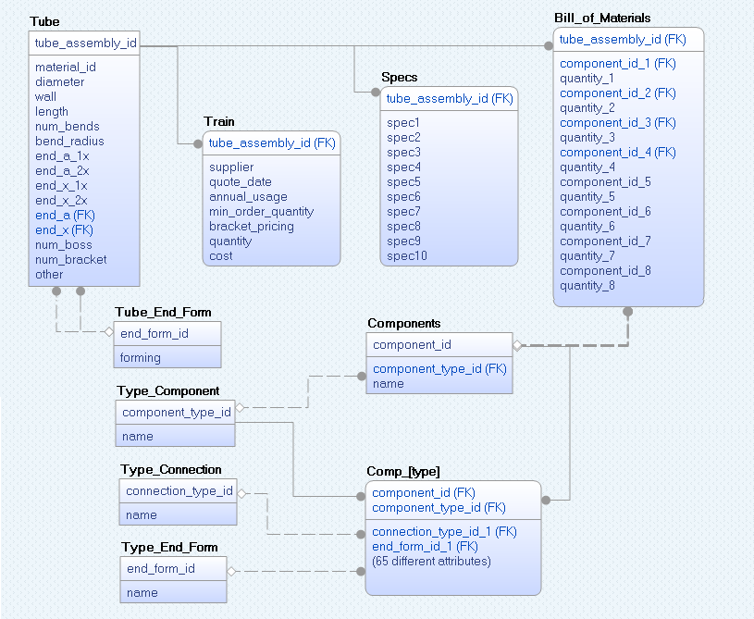
Key tables and relationship model
Group

Slide 23
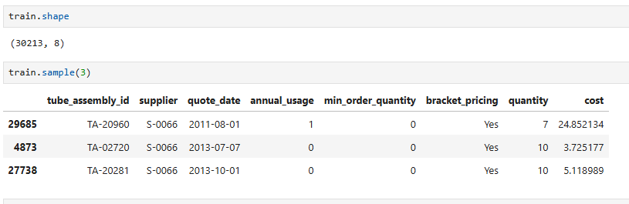
Train Dataset - Number of columns and rows
Group

Slide 24
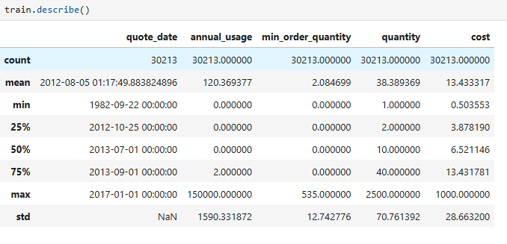
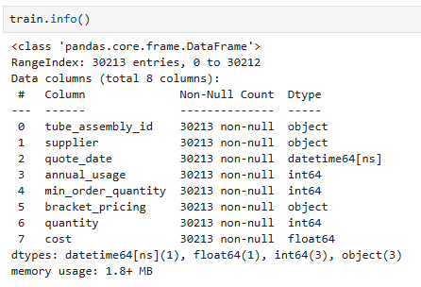
Train Dataset - Key statistics and data types
Group

Slide 25
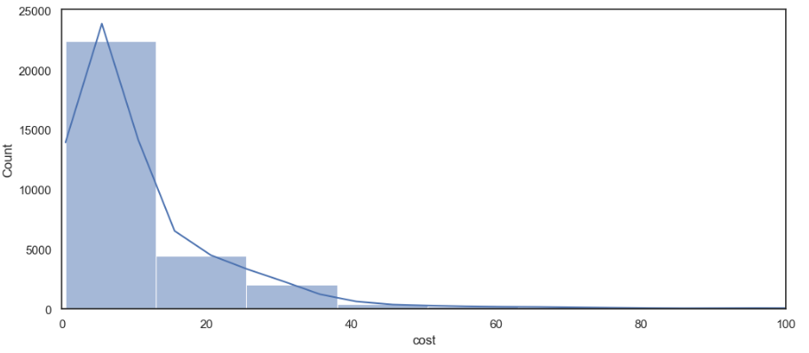
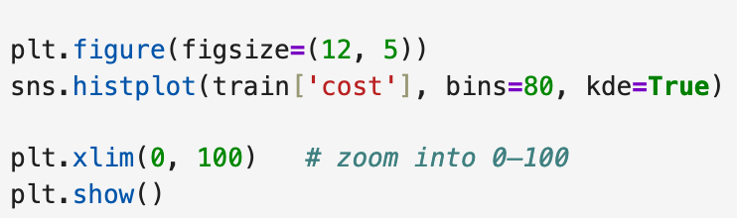
Cost Distribution (Train Dataset)
Group

Slide 26
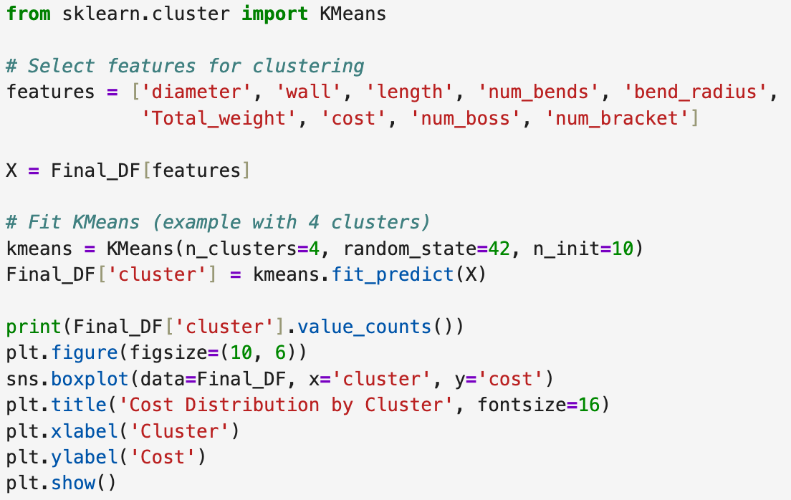
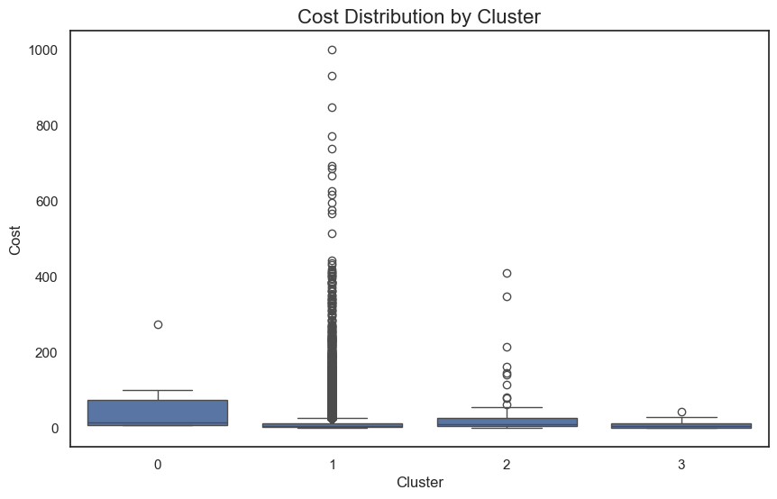
Cost clusters
Cluster | Pattern | Interpretation
Cluster 0 | Medium spread, highest median among the low-cost groups | Relatively consistent costs, mostly between ~10 to ~100. Some high outliers up to ~280.
Cluster 1 | Very wide-spread + many extreme outliers | Most interesting cluster. Huge variation in cost — from very cheap to extremely expensive (up to ~1000). Lots of outliers above 400–900. This cluster likely contains complex or highly customized tubes.
Cluster 2 | Moderate spread, some high outliers | Similar to cluster 0 but slightly higher variation. Many points between 0–50 with outliers up to ~400.
Cluster 3 | Very tight and low cost | Cheapest and most consistent cluster. Almost all tubes are low cost with very little variation. Looks like a "standard/simple" group.
Group

Slide 27
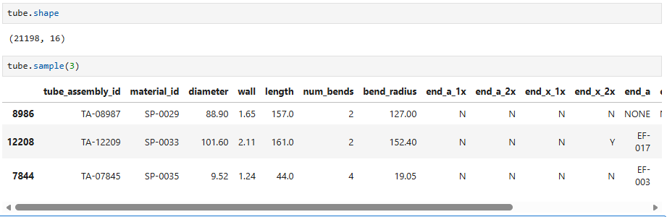
Tube Dataset - Number of columns and rows
Group

Slide 28
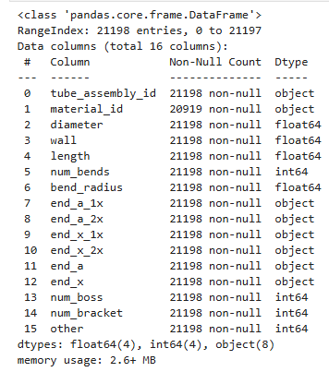
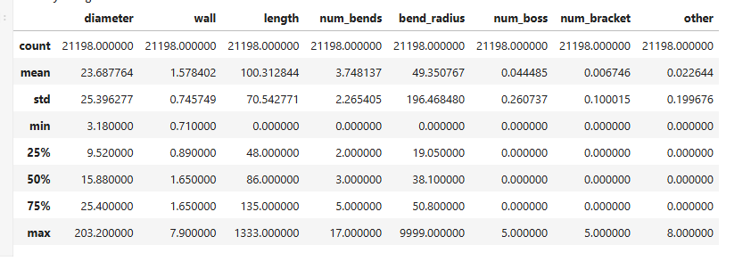
Tube Dataset- Key statistics and data types
Group

Slide 29
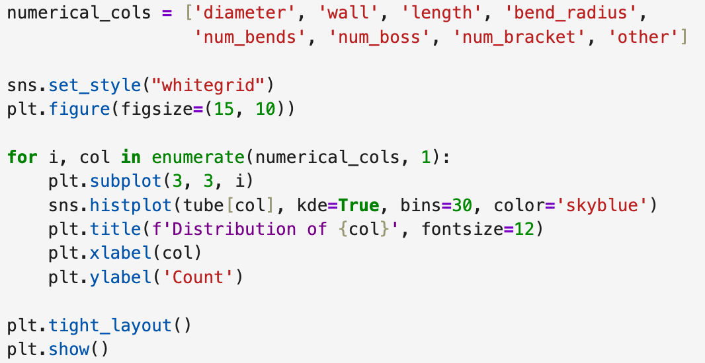
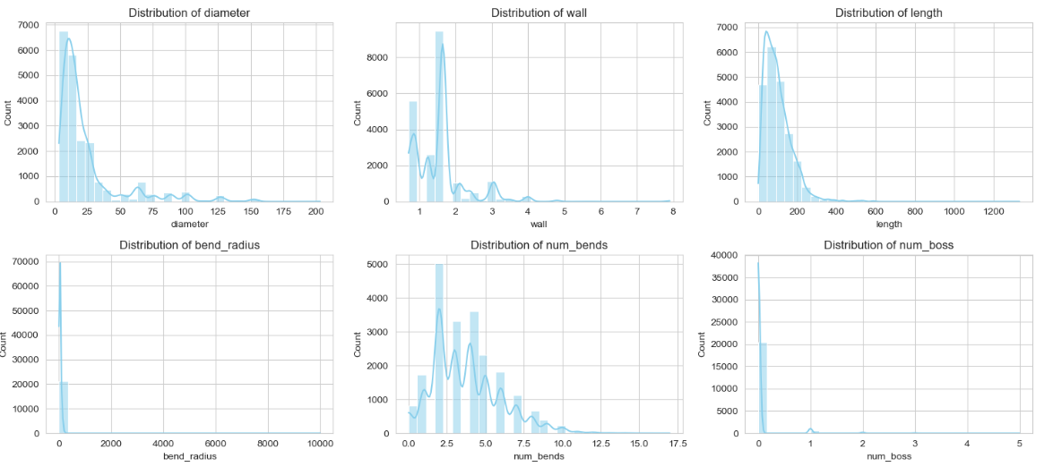
Tube Dataset - Numeric features distribution
Group

Slide 30
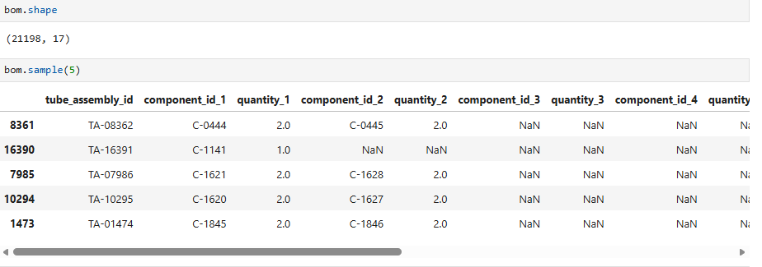
Bill of Material Dataset - Number of columns and rows
Group

Slide 31
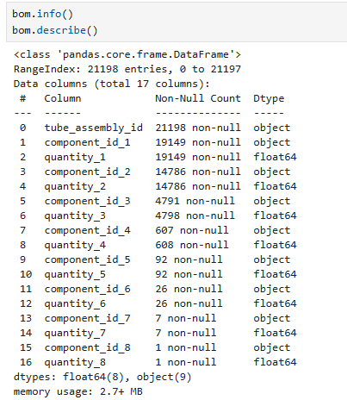
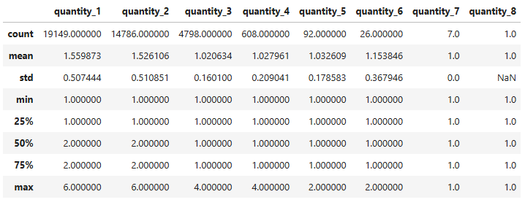
Bill of Material Dataset - Key statistics and data types
Group

Slide 32
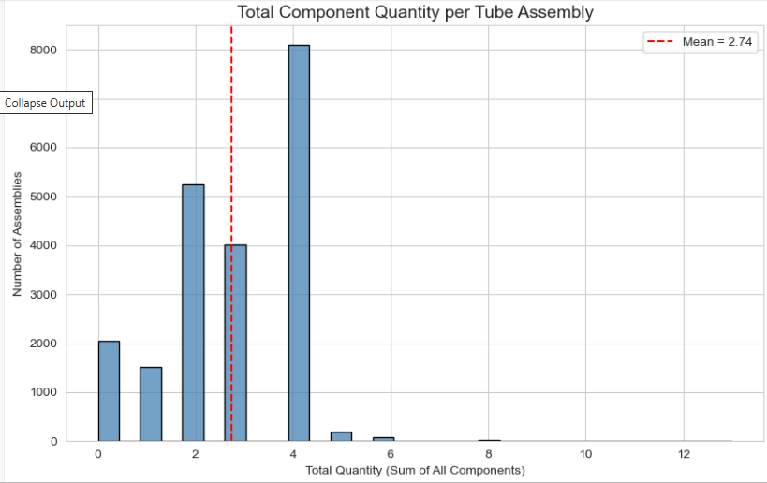
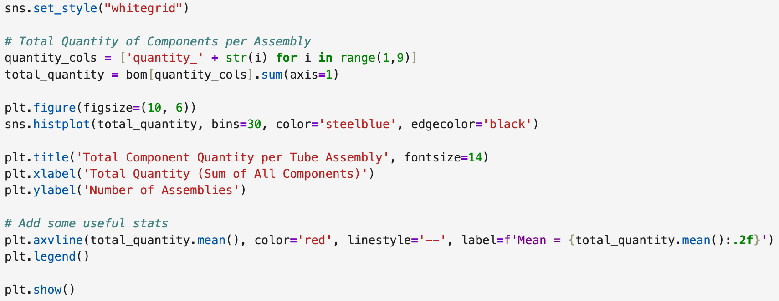
Bill of Material Dataset - Key statistics and data types
Group

Slide 33
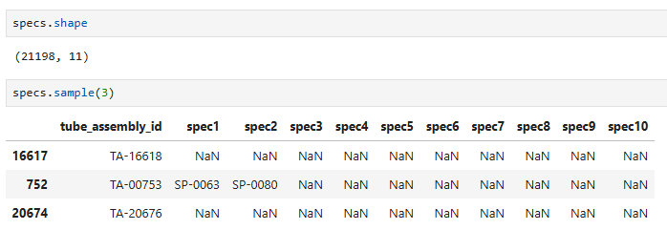
Specification Dataset - Number of columns and rows
Group

Slide 34
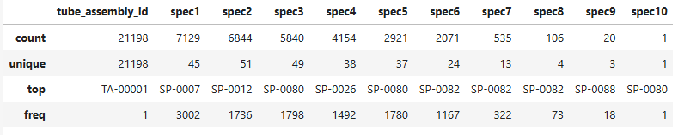
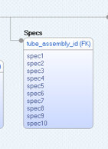
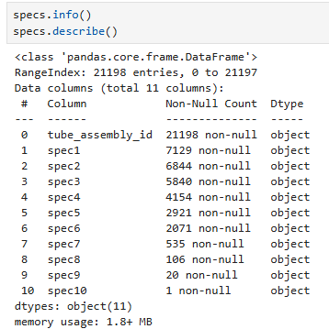
Specification Dataset - Key statistics and data types
Limitation: no look up table to explain us specifications entries which are in form of an ID
Group

Slide 35

Verify Data Quality

Slide 36
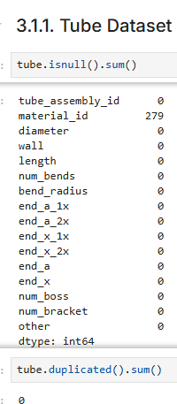
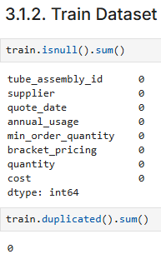
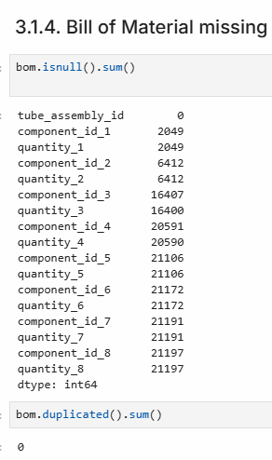
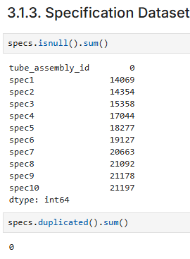
Missing values and duplicates
Group

Slide 37
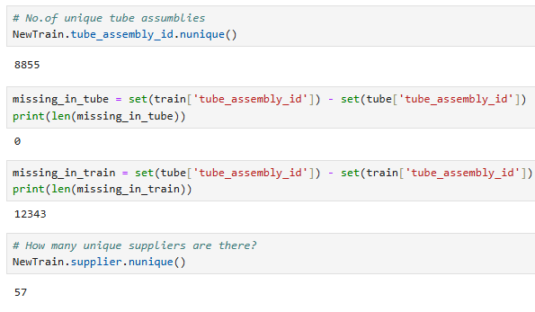
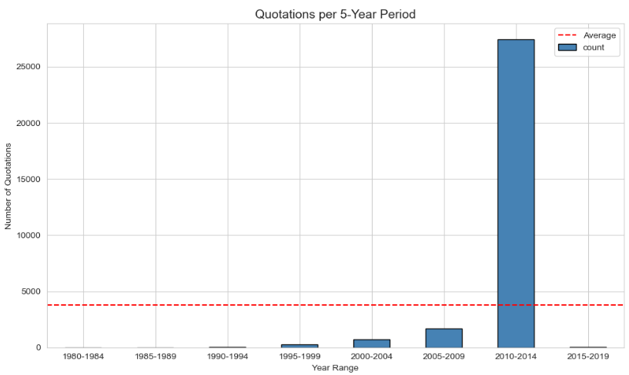
Additional quality checks
Group

Slide 38
Feature Engineering

Slide 39
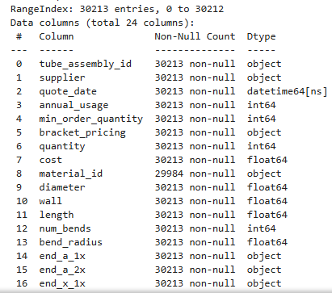
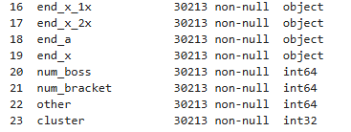
1) Merging Relational Datasets: Combined multiple datasets using tube_assembly_id as the primary key to create a unified dataset
NewTrain = pd.merge(train, tube, on ='tube_assembly_id')
Group

Slide 40
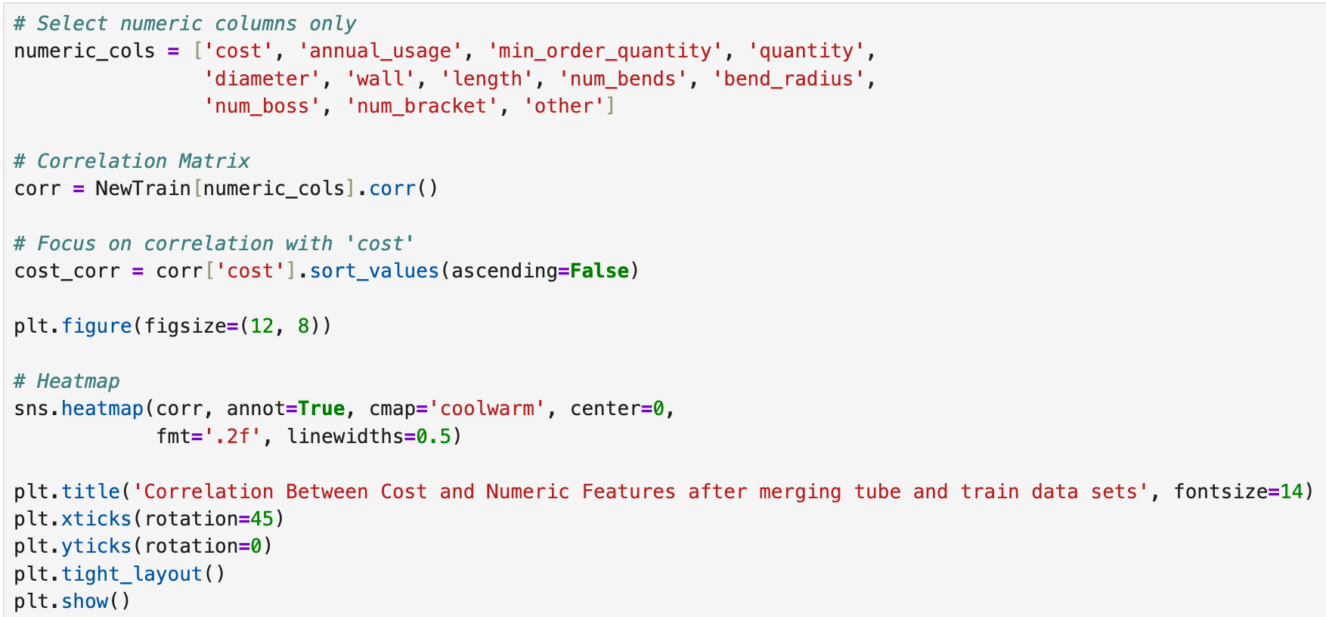
Correlation between cost and numeric features after merging tube and train data sets
Group

Slide 41
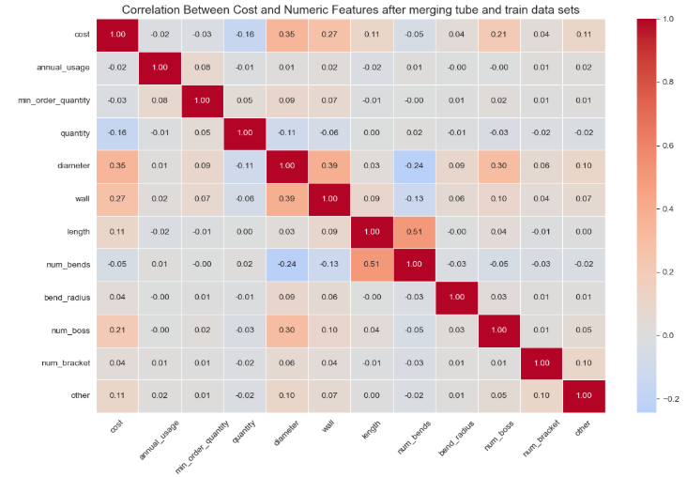
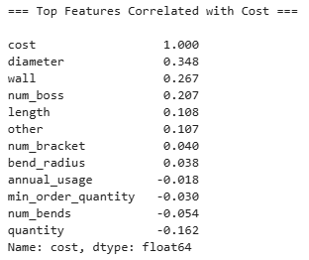
Correlation between cost and numeric features after merging tube and train data sets
This highlights the importance of the calculation of additional features such as total weight and total quantity based on available data.
Group

Slide 42

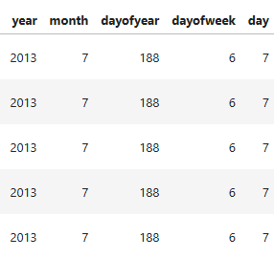
2) Date Feature Extraction: Created new columns by splitting quote_date into day, month, and year for better time-based analysis
Captures seasonal & monthly patterns
Improves machine learning model performance
Better feature interaction
Group

Slide 43
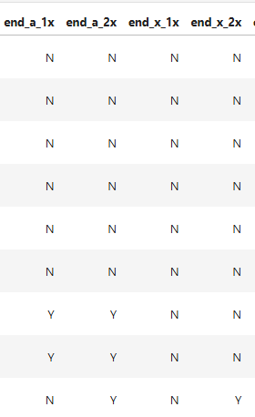
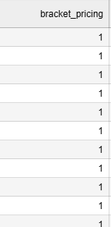
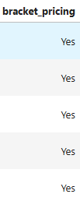
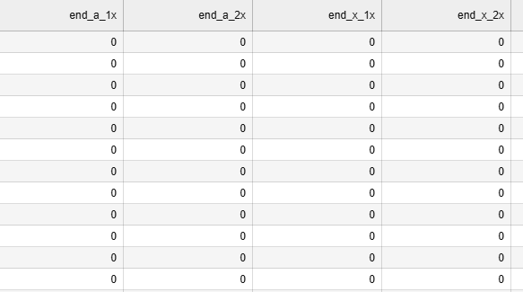
3) Categorical Encoding: Converted categorical/text variables into numerical format to make them suitable for machine learning models
Group

Slide 44
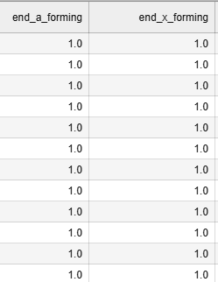

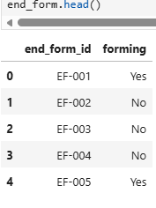
4) End Forming Features: Used lookup table (tube_end_form) to extract forming information from end_a and end_x columns. Created new relevant forming features and removed missing values.
Group

Slide 45
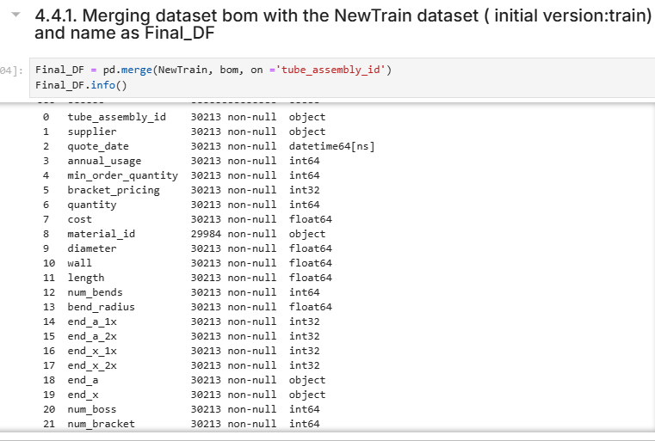
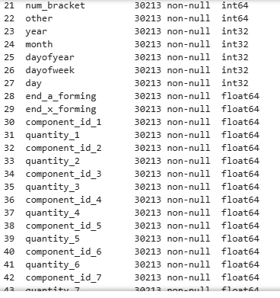
5) Bill of Materials (BOM) Aggregation
Group

Slide 46
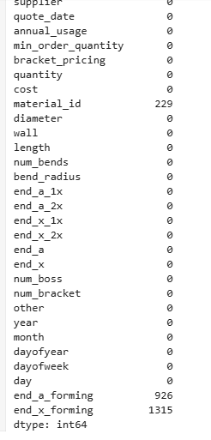
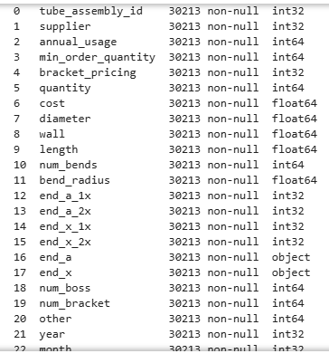
6) Data Cleaning
Replacing missing values in forming with 0
Remove date as it is now extracted to new features
Material ID, not much useful information
Group

Slide 47
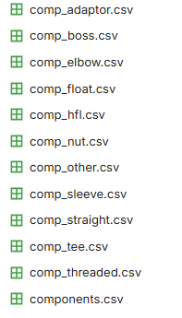
6) Bill of Materials (BOM) Aggregation with Component type to import weight feature for each component
There are a total of 11 comp_[name] files, which contains the details for each component including weight.
In general, the heavier a tube is, the more expensive it can be. In addition, the more quantity required, the more expensive a tube can be.
Thus, we'll try to extract the total quantity and total weight features for each tube.
Group

Slide 48
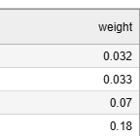
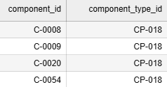
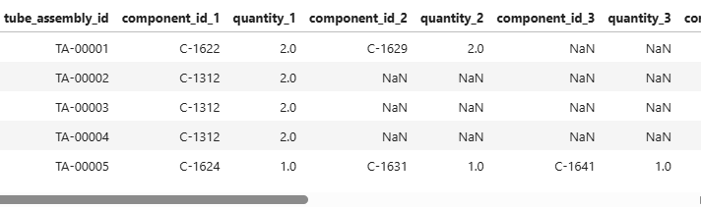


6) Bill of Materials (BOM) Aggregation with Component type to import weight feature for each component
(this table is 3 col of com_boss) we have 10 other comp as listed in last slide
Group

Slide 49


7) Determining total quantity and weight of tube from dataset bill of material
Group

Slide 50


Transforming Cost
We applied a log transformation to the target cost variable to handle its right-skewed distribution.
This improved model learning, reduced the influence of extreme values, and enhanced overall prediction accuracy.
Group

Slide 51



Final Clean, merged and dataset including added new columns/features
Group

Slide 52


Correlation matrix
Group

Slide 53
Machine Learning Algorithms (Overview)

Slide 54

Linear Regression
/
KNN
Used to predict price (continuous value)
Finds relationship between features and cost
Splits data into multiple parts
Tests model several times
Gives more reliable results
Why Used?
Suitable for pricing prediction
Simple and easy to interpret
Chinelo Lydia Nweke

Slide 55
Extreme Gradient Boosting (XGBoost)
GradientBoostingRegressor
- XGBoost is a gradient boosting library that builds many decision trees sequentially to improve predictions.
- Plan: Use XGBoost to model the supplier quote price with strong predictive accuracy.
- Benefit from gradient boosted trees that handle nonlinear relationships and feature interactions.
- Apply it to the merged dataset with tube geometry, component counts, and pricing regime indicators.
- Leverage built-in regularization and tree-based feature importance for model stability and interpretability.
Takal Ebrahimkhel

Slide 56
CatBoost (Decision Tree)
HistGradientBoostingRegressor
Features
Native categorical handling works directly with categorical features (no manual encoding)
Ordered boosting: reduces overfitting and improves generalization
Symmetric decision trees: faster training and more stable predictions
Minimal preprocessing: handles missing values and mixed data types automatically
High performance: strong accuracy on tabular datasets with little tuning
Applications
Structured/tabular data problems (
Regression & classification tasks
Industry use cases: demand forecasting, risk modeling, recommendation systems
Datasets with many categorical variables where traditional models struggle
Mohammad Sharif Azimy

Slide 57
Random Forest
Bagging technique: Builds multiple decision trees independently using random subsets of data.
Feature randomness: Selects a random subset of features for each split, reducing correlation between trees.
Robustness: Highly resistant to overfitting and works well with high-dimensional data.
Versatility: Handles both classification and regression tasks with minimal hyperparameter tuning.
Interpretability: Provides clear feature importance scores to understand which variables drive predictions.
Antonios Stefanakis

Slide 58
Extra Trees
Extreme Randomization: Unlike Random Forest, it chooses split points completely at random for each feature.
High Efficiency: Faster training speed because it doesn't search for the optimal split threshold mathematically.
Variance Reduction: Provides even better generalization by further reducing the model's sensitivity to noise.
Use Cases: Ideal for very large datasets or scenarios where computational resources are limited.
Performance: Often achieves similar or better accuracy than Random Forest while being computationally cheaper.
Antonios Stefanakis

Slide 59
1. Model Selection
Machine Learning Algorithms - Mohammad Sharif Azimy
CatBoost Regressor was selected as the primary model because:
Excellent at handling tabular data with mixed feature types
Built-in support for categorical features and missing values
Strong regularization to prevent overfitting on industrial datasets
Good performance on medium-sized structured data like tube assembly records
HistGradientBoostingRegressor was chosen as a strong secondary model because:
Highly efficient histogram-based splitting for fast training on tabular data
Native Scikit-learn implementation with good memory efficiency
Built-in support for missing values and automatic handling of numerical features
Suitable for datasets with physical measurements and business metrics
Task 7 - Mohammad Sharif Azimy

Slide 60
2. System Architecture – End-to-End Pipeline
Input Data\Multiple CSV Files
Feature Engineering\Total_weight, diameter, length, wall\
Remove Redundant Features
Feature Selection\ f_regression + Permutation Importance
Evaluation\
Train/Val/Test Split\
5-Fold CV\
Early Stopping
Final Output\
Cost Predictions\
Performance Metrics MAPE
Preprocessing\
Cleaning + Merging
Target Transformation\
cost → cost_transformed ^(1/20)
Model Training\
CatBoost + HistGradientBoosting
Interpretation\
SHAP Analysis
Task 7 - Mohammad Sharif Azimy

Slide 61
3. Metrics
MAPE (Mean Absolute Percentage Error) Average percentage error between actual and predicted cost. Most important business metric
MAE (Mean Absolute Error) Average absolute unit error(for example USD), Shows typical deviation
RMSE (Root Mean Square Error) Measures average error while penalizing large mistakes more. → Sensitive to big prediction errors
Task 7 - Mohammad Sharif Azimy

Slide 62
Task 7 - Mohammad Sharif Azimy
3. Experimental Plan
Aspect | Details
Validation Strategy | Train / Validation / Test Split (70% / 15% / 15%) + 5-Fold Cross Validation + Early Stopping on Validation Set
Models Compared | - CatBoost Regressor (Primary Model) - HistGradientBoostingRegressor (Strong Alternative) - Random Forest (Baseline)
Hyperparameter Tuning | Manual tuning + Early Stopping Key parameters: iterations, learning rate, depth, subsample
Final Selection Criteria | - Best MAPE on Cross-Validation - Logical SHAP explanations - Model stability & generalization - Training speed
Final Chosen Solution | CatBoost as the primary model, with HistGradientBoostingRegressor as a strong secondary option
Task 7 - Mohammad Sharif Azimy

Slide 63


Features Selection Method
1) f-regression: Measures linear correlation with the target (cost_transformed)
2) Permutation Importance: Measures non-linear effects and interactions)
Key Selected Features
diameter: Strongest linear predictor (bigger tubes cost more)
min_order_quantity : Strong negative correlation (higher quantity → lower unit cost due to economies of scale)
Total_weight: High importance in both methods (physical weight strongly affects material cost)
wall Thickness is a significant material cost driver
length : Important physical dimension
Redundant features ignored (e.g., component_id, quantity), these were excluded because they are already incorporated in Total_weight
Final Selected Features : Total_weight, min_order_quantity, diameter, annual_usage, bracket_pricing, length, wall
Task-8 Mohammad Sharif Azimy

Slide 64




CatBoost design and implementation
We split the data into three parts: Training Set (70%) — Used to train the model Validation Set (15%) — Used for hyperparameter tuning and early stopping to prevent overfitting Test Set (15%) — Kept completely unseen for final unbiased evaluation
The model was trained with 1000 iterations, depth of 8, and early stopping based on validation performance. This approach ensures the model generalizes well to new data.
The final performance on the test set was measured using RMSE, MAE, and MAPE, providing a comprehensive view of prediction accuracy. This systematic approach — from correlation analysis to careful validation — helped us build a reliable cost prediction model for the tube assemblies.
Task-8 Mohammad Sharif Azimy

Slide 65

CatBoost Regressor Results (with Validation Set)
1
2
3
4
5
6
Trained using Train / Validation / Test split (70% / 15% / 15%)
Used early stopping on validation set to prevent overfitting
Best iteration reached at 999
RMSE (Root Mean Squared Error): 0.0188 → Measures the average magnitude of prediction errors. Lower is better. Our model’s predictions are very close to actual values.
MAE (Mean Absolute Error): 0.0109 → Shows the average absolute difference between predicted and actual values. Easy to interpret in the same unit as the target.
MAPE (Mean Absolute Percentage Error): 0.97% → Indicates the average percentage error. Our model’s predictions are off by less than 1% on average — excellent accuracy for cost prediction.
Task-8 Mohammad Sharif Azimy

Slide 66

Evaluation and Improvement -Fine Tuning
Used CatBoost Regressor as the primary model
Split data into Train (70%) / Validation (15%) / Test (15%)
Applied hyperparameter tuning:
  Iterations: 1000–2000
  Learning rate: 0.05 → 0.03
  Depth: 8
  Subsample: 0.8
Implemented early stopping (50 rounds) based on validation set performance
Final Performance on Test Set:
RMSE: 15.53
MAE: 5.55
MAPE: 20.74%
Task-9 Mohammad Sharif Azimy

Slide 67

5-Fold Cross Validation Results
Method: 5-Fold Cross Validation applied to assess model stability and generalization capability Objective: Validate that the model performs consistently across different data subsets and is not overly dependent on any specific train-test split Key Performance Summary: Average RMSE: 15.37 ±1.31
Average MAE: 3.69 ± 0.17
Average MAPE: 21.93% ± 0.51%
Interpretation: stable performance across all five folds
Very low standard deviation indicates high consistency and robustness
Excellent generalization across different subsets of the tube assembly cost dataset
Task-9 Mohammad Sharif Azimy

Slide 68

SHAP Analysis
To interpret the model’s predictions, I applied SHAP, a powerful technique that explains the contribution of each feature to individual predictions.The SHAP summary plot reveals that min_order_quantity has the highest impact on the predicted cost, followed by Total_weight and diameter. This suggests that order quantity and physical properties of the tube are the most influential factors.Interestingly, min_order_quantity shows a strong negative impact in many cases, aligning with our earlier correlation analysis — higher minimum order quantities tend to reduce the cost per unit due to economies of scale.This interpretability analysis gives us confidence that the model is learning meaningful business and physical patterns rather than random noise
Task-9 Mohammad Sharif Azimy

Slide 69

Comparing with HistGradientBoostingRegressor
In addition to CatBoost, I implemented HistGradientBoostingRegressor from Scikit-learn to compare different gradient boosting approaches. This model is known for its speed and efficiency due to histogram-based splitting. Using the same selected features and validation strategy, it achieved a strong MAPE of 26.03%, which is almost close to CatBoost’s performance. This shows that a native Scikit-learn boosting algorithm can deliver competitive results with faster training time and simpler implementation. The slight difference in performance demonstrates the strength of both models, while HistGradientBoostingRegressor offers a good balance between accuracy and computational efficiency
Task-9 Mohammad Sharif Azimy

Slide 70
Linear Regression models the relationship between features and a continuous target as a weighted sum:
price = β₀ + β₁·diameter + β₂·quantity + ... + βₙ·feature_n
Machine Learning Algorithms - Chinelo Lydia Nweke
KNN (K-Nearest Neighbours) is non-parametric, it fits no equation. Instead, to predict the price of a new tube assembly, it finds the K most similar assemblies in the training data and averages their prices.

Slide 71

Evaluation Metrics used:
MAE (Mean Absolute Error): Average dollar difference between predicted and actual price — lower is better
RMSE (Root Mean Squared Error): Like MAE but penalises large errors more heavily — lower is better
R² Score: How much of the price variation the model explains — higher is better

Slide 72

System Architecture and Experimental Plan
Baseline Performance:
Compare model performance against average price price prediction baseline
Experimental Plan
1
2
3
4
5
By Chinelo
Train-test split
5-Fold Cross-Validation
Hyper parameter tunning
Compare models using RMSE and R²
Basic feature selection and parameter tuning
Results documented using tables and charts

Slide 73
MODEL DESCRIPTION
Linear Regression: Theory & Parameters
Linear Regression models the relationship between features and a continuous target as a weighted sum:
price = β₀ + β₁·diameter + β₂·quantity + ... + βₙ·feature_n
Hyperparameters (set before training):
  Ridge α (L2): penalises large coefficients keeps all features but shrinks them
  Lasso α (L1): penalises large coefficients drives weak ones to exactly zero (feature selection)
  Tested: Ridge α ∈ {0.01, 0.1, 1, 10, 100, 1000} | Lasso α ∈ {0.0001, 0.001, 0.01, 0.1, 1}
Parameters (learned from data during training):
  Coefficients (β): one per feature, how much each feature shifts the predicted price
  Intercept (β₀): the baseline price when all features are zero

Slide 74
MODEL DESCRIPTION
KNN Regression: Theory & Parameters
KNN (K-Nearest Neighbours) is non-parametric, it fits no equation. Instead, to predict the price of a new tube assembly, it finds the K most similar assemblies in the training data and averages their prices.
Similarity is measured by distance in feature space:
  Euclidean: √(Σ(xᵢ - xⱼ)²) standard straight-line distance
  Manhattan: Σ|xᵢ - xⱼ| sum of absolute differences (less sensitive to outliers)
Hyperparameters (set before training):
  K (n_neighbors): number of neighbours to average, tested: K ∈ {3, 5, 7, 10, 15, 20, 25, 30}
  Distance metric: Euclidean vs Manhattan, tested in Task 9 enhancement
  StandardScaler required: without scaling, quantity (up to 2500) dominates distance over wall (0.7–7.9)
Parameters None learned - KNN memorises the training data directly

Slide 75
MODEL JUSTIFICATION
Why These Two Models?
Criterion | Linear Regression | KNN Regression
Interpretability | High — coefficients explain each feature's contribution | Low — no equation, black-box prediction
Assumptions | Assumes linear relationship between features and price | No assumptions about data shape
Speed | Fast training and prediction | Slow prediction on large datasets
Handles non-linearity | No — global straight-line equation | Yes — captures local pricing clusters

Slide 76

Feature Selection & Data Preparation
Step 1 - Power Transformation:
Cost is severely right-skewed. Training on raw dollars destabilises gradients.
cost_transformed = cost ** (1/20) all predictions back-transformed: clip(pred, 0) ** 20
Step 2 - F-Regression on all 45 numeric features:
Selected top 7 by F-Score (all p-values = 0.000):
Feature | F-Score | MI Score
diameter | 5,907 | 0.197
min_order_quantity | 5,582 | 0.621
quantity | 5,470 | 0.612
Total_weight | 3,719 | 0.366
wall | 3,401 | 0.165
length | 940 | 0.203
Total_quantity | 398 | 0.149

Slide 77


3-Way Split &
Pipeline Design
Set | Rows | Share | Purpose
Training | 18,127 | 60% | Model fitting + cross-validation
Validation | 6,043 | 20% | Comparing tuned models
Test | 6,043 | 20% | SEALED, opened once in Phase 5
StandardScaler inside the pipeline ensures the scaler is fitted only on training data never on validation or test rows.

Slide 78

PERFORMANCE ANALYSIS, INITIAL MODEL
LR Baseline: Model A vs Model B
Two baselines trained to justify the transformation choice:
Model | Val MAE ($) | Val RMSE ($) | Val R² | 5-Fold CV R²
Model A — raw cost | $10.04 | $27.71 | 0.222 | 0.262
Model B — cost^(1/20) | $8.70 | $31.26 | 0.01 | 0.373
Key finding: Validation R² alone is misleading — Model A appears better (0.22 vs 0.01). But 5-fold CV reveals Model B is 43% more consistent across data subsets (0.37 vs 0.26). Cross-validation is essential when cost outliers cluster in one split
➡ Model B (power-transformed) selected for all tuning.

Slide 79


KNN Baseline + Tuning
KNN Baseline (K=5, power-transformed target):
Metric | Value
Val MAE | $6.54
Val RMSE | $23.67
Val R² | 0.4325
5-Fold CV R² | 0.596
Already much stronger than Linear Regression baseline (CV R² 0.60 vs 0.37)
GridSearchCV - best K search (K = 3 to 30):
K | CV MAE (transformed)
3 | 0.02188 ← Best
5 | 0.02205
7 | 0.02237
10 | 0.02274
15 | 0.02304
20 | 0.02338
observation: KNN baseline with default K=5 already outperforms the best tuned LR model on validation (R² 0.43 vs 0.09). This strongly suggests that supplier pricing has non-linear local structure that a global linear equation cannot capture.
Best K = 3 - small K captures fine-grained local pricing patterns in this dataset

Slide 80


LR Improvement: Ridge vs Lasso Tuning
GridSearchCV — 5-fold CV on training set only, validation sealed throughout:
Results:
Model | Best Alpha | CV MAE | Validation MAE ($) | Validation R²
Ridge (L2) | 0.01 | 0.0326 | $8.70 | 0.01
Lasso (L1) | 0.001 | 0.0326 | $8.55 | 0.093
Lasso wins - its automatic feature selection (zeroing weak coefficients) removes residual noise. R² improves from 0.01 to 0.09 with Lasso.
Ridge: Shrinks all coefficients toward zero, reduces variance, and retains all features
Lasso: Drives weaker coefficients to exactly zero automatic feature selection
Both achieve near-identical CV MAE (0.0326), the difference emerges at validation in Phase 4.

Slide 81


KNN Improvement: Finding Best K
GridSearchCV over K = 3 to 30:
K vs CV MAE:
K=3 wins — small K captures fine-grained local pricing clusters. As K increases, the model averages too broadly and loses local signal.
K | CV MAE |  | K | CV MAE
3 | 0.02188 ← Best |  | 15 | 0.02304
5 | 0.02205 |  | 20 | 0.02338
7 | 0.02237 |  | 25 | 0.02367
10 | 0.02274 |  | 30 | 0.0239

Slide 82

Enhancements: 3 Experiments
Three targeted experiments based on identified weaknesses:
Experiment | What Changed | Val MAE ($) | Val R² | Outcome
Exp 1: SelectKBest top 5 | Reduced features from 7 to 5 (removed length, Total_quantity) | $8.67 | 0.015 | Marginal gain — noise reduction minor
Exp 2: Polynomial features | Added degree-2 interaction terms (22 features total) | FAILED | −3.6×10²⁶ | Numerical overflow — underfitting exploded
Exp 3: Manhattan distance | Changed KNN distance metric from Euclidean to Manhattan | $6.38 | 0.427 | Best — more robust to outliers in quantity
Why Exp 2 failed: Polynomial terms like quantity² reach 6.25 billion while wall² stays under 1. Ridge with small alpha (0.01) cannot control these extreme scales, the model blows up. Stronger regularisation and rescaling after expansion would be needed.

Slide 83

Error Analysis: Where the Model Fails
Pattern: Error scales roughly in proportion with cost. For the 86% of assemblies priced under $20, the model is highly accurate (MAE $1.94–$5.03). For high-cost assemblies above $100 (only 0.26% of quotes), mean error is $98, the model severely underestimates complex, expensive assemblies.
Root cause: High-cost assemblies have rare feature combinations (very large diameter, heavy components, long length all together). KNN finds their nearest neighbours in a sparse region of feature space, the few similar training examples may not closely represent the true price.
Cost Bracket | Quotes | Mean Error ($) | Median Error ($)
$0–10 | 3,930 | $1.94 | $0.60
$10–20 | 1,002 | $5.03 | $3.35
$20–50 | 931 | $11.85 | $9.54
$50–100 | 102 | $33.29 | $28.25
$100+ | 78 | $98.15 | $79.62

Slide 84

COMPARISON OF ML MODELS
Head-to-Head: LR vs KNN
KNN wins on all performance metrics. LR wins on interpretability.
Metric | LR (Lasso α=0.001) | KNN (K=3 Manhattan) | Winner
Test MAE | $7.93 | $5.75 | KNN
Test RMSE | $24.31 | $18.93 | KNN
Test R² | 0.121 | 0.467 | KNN
CV R² | 0.365 | 0.607 | KNN
Training speed | Fast | Fast | Tie
Interpretability | High (SHAP) | Low | LR
Handles non-linearity | No | Yes | KNN

Slide 85



LR Explainability: Standardised Coefficients
Global bar plot: average absolute SHAP value per feature across all validation rows, confirming min_order_quantity and quantity as the top two drivers.
Dot summary plot: shows both direction and magnitude. Red = high feature value, blue = low. High quantity pushes cost up while high min_order_quantity pushes cost down.
min_order_quantity has the largest magnitude — a higher minimum order threshold is associated with lower per-unit cost (bulk discount effect). All physical dimensions (diameter, wall, length, Total_weight) push cost up, consistent with business intuition.

Slide 86

Why KNN Outperforms Linear Regression
High-cost underestimation
Low linear R²
Possible feature noise
No interaction terms
Both models underestimate assemblies priced above $50. The power back-transformation (pred ** 20) amplifies small errors in the transformed scale into very large dollar errors at the expensive end.
Lasso R² = 0.09 on validation. Pricing depends on non-linear interactions between features (e.g. a wide-diameter, thick-wall, long tube) that a global linear equation cannot capture.
The feature set contains individual measurements (diameter, wall, length) but no cross-products. A term like diameter × length represents physical cross-section area — a known cost driver not currently encoded.
With 7 features, some may be adding noise rather than signal. SelectKBest may find a cleaner 5-feature subset that generalises better.
KNN outperforms Linear Regression on every metric across every phase. The gap is large — KNN reduces MAE by 25% ($6.42 vs $8.55) and more than doubles R² (0.45 vs 0.09).

Slide 87
Machine Learning Algorithms - Takal Ebrahimkhel

Slide 88
Task 7
Model Selection
XGBoost is the primary model; GradientBoostingRegressor is the secondary benchmark.
• Business problem: predict continuous tube assembly cost from supplier, geometry, date, and BOM features.
• Algorithms considered: Dummy baseline, Linear/Ridge, Random Forest, GradientBoostingRegressor, XGBoost.
• Chosen main algorithm: XGBoost Regressor for nonlinear tabular regression and regularized boosted trees.
• Secondary algorithm: GradientBoostingRegressor for a strong scikit-learn comparison model.
• Selection logic: choose the model with strongest validation performance, especially RMSE and RMSLE.
Main choice: XGBoost Regressor
Takal Ebrahimkhel

Slide 89
System Architecture Diagram
Task 7
Workflow from final data table to validated cost prediction
Final_DF.csv
Preprocess
70/15/15 split
Modeling
Evaluation
Business use
Cleaned merged quote table
Impute + one-hot encode
Train, validate, final test
XGBoost + GBR + baseline
Metrics, SHAP, error analysis
Quote benchmark + risk flags
Data and model governance layer
Validation set controls model selection; test set remains untouched until final reporting.
Saved outputs include metric tables, predictions, feature importance, SHAP values, plots, and a model bundle.
The system is designed to support procurement quote benchmarking, not to replace domain review for rare high-cost assemblies.
Task 7
Takal Ebrahimkhel

Slide 90
Evaluation Metrics Definition
Task 7
How prediction quality is measured for tube assembly cost
MAE
Average absolute dollar error. Easy for procurement stakeholders to interpret.
RMSE
Penalizes large errors more strongly. Primary metric because high-cost quote misses matter.
R2
Share of cost variance explained by the model on unseen data.
RMSLE
Relative-error metric for skewed positive cost data; useful when prices vary widely.
MAPE
Average percentage error; helpful for business communication but unstable near very small costs.
Mean Absolute Error (MAE), Root Mean Squared Error (RMSE), R-Squared (R2), Root Mean Squared Log Error (RMSLE), Mean Absolute Percentage Error (MAPE)
Task 7
Takal Ebrahimkhel

Slide 91

Experimental Plan
Task 7
Reproducible comparison, tuning, feature selection, and final testing
Modeling sequence
Enhancement checks
1. Train median baseline
2. Train GBR and XGBoost baselines
3. Tune GBR and XGBoost with RandomizedSearchCV
4. Select final model on validation RMSE
5. Evaluate once on untouched test set
Feature importance ranking
Top-30 feature-selection experiment
Residual and cost-band error analysis
SHAP global and directional explanation
Business-impact translation
Task 7
Takal Ebrahimkhel

Slide 92

Implementation Setup
Tasks 8-9
Final_DF.csv import, preprocessing, and required 70/15/15 validation setup
Why this matters
Rows used: 30,213
Train / validation / test rows: 21,149 / 4,532 / 4,532
The test set is not used for tuning.
Categorical variables are one-hot encoded; numeric variables are median-imputed.
Log-cost modeling improves stability for skewed positive prices.
Tasks 8-9
Takal Ebrahimkhel

Slide 93


Implemented Models and Validation Results
Baseline, secondary model, and primary XGBoost comparison
11.55
0.842
29.96
XGBoost
Best validation RMSE
Best validation R2
Baseline RMSE
Selected model
This slide shows the main validation results. The median baseline has a validation RMSE of about 29.96, which shows the error level if we do not learn meaningful pricing relationships. The tuned XGBoost model is best with validation RMSE of about 11.55 and validation R squared of about 0.842. The XGBoost baseline is also strong, but tuning improves it further. GradientBoostingRegressor is useful as the secondary benchmark, but it does not match XGBoost on the validation set. Therefore, the validation evidence supports choosing tuned XGBoost for final testing.
Tasks 8-9
Takal Ebrahimkhel

Slide 94

Hyperparameter Tuning
Tasks 8-9
RandomizedSearchCV improves the primary model before final selection
Best XGBoost parameters
n_estimators = 314
max_depth = 7
learning_rate = 0.082
subsample = 0.986
colsample_bytree = 0.995
reg_lambda = 0.663
Tuning searches realistic combinations instead of relying on defaults.
Validation RMSE chooses the model because high-dollar misses matter.
The tuned model beats untuned XGBoost by about 1.02 RMSE points.
I used RandomizedSearchCV to test combinations of tree count, learning rate, depth, subsampling, column sampling, and regularization. The best XGBoost configuration used 314 trees, max depth 7, learning rate about 0.082, and high subsampling and column sampling. Tuning matters because default parameters may either underfit or overfit the cost data. In this run, the tuned XGBoost model improved validation RMSE from about 12.58 to 11.55, which is a meaningful improvement for quote prediction.
Tasks 8-9
Takal Ebrahimkhel

Slide 95


Feature Selection and Cost Drivers
Tasks 8-9
Important features connect model behavior to manufacturing logic
Interpretation
Minimum order quantity and quantity reflect pricing brackets and volume effects.
Total weight, diameter, and length reflect material and production effort.
Supplier and end-form indicators capture process and commercial differences.
Top-30 feature selection was tested but full tuned XGBoost performed best.
The broader feature set captures critical interactions that a smaller subset misses, justifying the inclusion of the full feature set.
Takal Ebrahimkhel

Slide 96


SHAP Explainability
Tasks 8-9
Global feature effects for the final XGBoost model
This slide presents the SHAP analysis. SHAP explains how each feature contributes to the model's prediction, which makes the XGBoost model less of a black box. The global bar chart shows that minimum order quantity is the strongest contributor, followed by total weight, annual usage, diameter, length, quantity, and bracket pricing. The beeswarm plot adds direction and spread, showing how individual validation rows are affected. This is important for stakeholders because we can explain why a predicted cost is high or low instead of only reporting a number.
Takal Ebrahimkhel

Slide 97


SHAP Code and Dependence Check
Tasks 8-9
Notebook implementation behind the explainability result
The dependence check shows how the top feature changes model output direction on the log-cost scale; this supports root-cause analysis of individual high or low predictions.
Tasks 8-9
Takal Ebrahimkhel

Slide 98


Final Test Evaluation
Tasks 8-9
Performance on the untouched 15% test set
Final scores
$2.46
MAE
$11.00
RMSE
0.849
The tuned XGBoost model achieved a test MAE of about 2 dollars and 46 cents, RMSE of about 11 dollars, R squared of about 0.849, and RMSLE of about 0.214.
The actual-versus-predicted plot shows that most predictions follow the diagonal pattern, which means predicted costs generally track actual costs well.
R2
0.214
RMSLE
Tasks 8-9
Takal Ebrahimkhel

Slide 99


Error and Limitation Analysis
Tasks 8-9
Where the final model is strongest and weakest
Low-cost rows dominate the data and are predicted most accurately.
Errors increase for $50+ and especially $100+ assemblies because these examples are rarer and more variable.
Recommendation: flag high-cost predictions for human review instead of fully automating them.
Tasks 8-9
Takal Ebrahimkhel

Slide 100


Enhancement Log and Final Model Choice
Tasks 8-9
Documented experiments used to improve and select the model
Final decision
Tuned XGBoost is selected because it has the lowest validation RMSE and strong final test performance.
The top-30 feature model was useful as a feature-selection experiment, but it lost accuracy.
Cross-validation checks stability on training folds before the final test report.
Tasks 8-9
Takal Ebrahimkhel

Slide 101
Machine Learning Algorithms - Antonios Stefanakis

Slide 102
Model Selection
Antonios Stefanakis
ML Problem:
A Regression problem aimed at predicting the continuous target variable cost (unit price of tube assemblies for the Caterpillar supply chain).
Selected Models
Random Forest Regressor (Primary Model)
Extra Trees Regressor
Reasoning for Selection
Handling Non-Linearity: Manufacturing cost data involves complex, non-linear interactions between tube geometry (diameter, wall thickness, length) and component types. Tree-based ensemble methods very good at capturing these interactions without forcing manual mathematical transformations.
Robustness to Extreme Outliers: Data exploration revealed a skewed cost distribution with extreme outliers up to $1000. To prevent these from distorting the predictions, a target log-transformation was applied, successfully stabilizing the variance and ensuring robust model performance.
Native Feature Importance: Both algorithms provide transparent feature importance scores.

Slide 103

Antonios Stefanakis
System Architecture
[ POST PROCESSING & OUTPUT LAYER ]
Inverse log-transformation of predictions to revert the scale from log-space back to actual USD
[ EVALUATION & VALIDATION LAYER ]
Mathematical tracking of standard regression errors: MAE, RMSE, and R² Score.
Integration of RMSLE (Root Mean Squared Logarithmic Error) to safely evaluate relative percentage-based pricing errors.
[ PREPROCESSING PIPELINE ]
[ MODELING & HYPERPARAMETER TUNING LAYER ]
Data partitioning into an 70% Training set, a 15% Validation set and a 15% Testing set
Feature normalization of continuous metrics (diameter, wall, length) using Standard Scaling
Target Transformation: Apply log-transformation to the cost variable to create cost_transformed
Training of parallel bagging tree ensemble models: Random Forest Regressor (Primary) and Extra Trees Regressor (Benchmark).
Implementation of an internal 5-Fold Cross-Validation scheme within the training set to prevent overfitting.
Optimization of tree parameters cost_transformed

Slide 104
Evaluation Metrics Definition
Antonios Stefanakis
1. MAE (Mean Absolute Error)
The average absolute error expressed directly in currency (dollars).
Business Metric Value: This serves as an intuitive metric for Caterpillar's procurement team, showing the typical dollar deviation from real supplier quotes.
2. RMSE (Root Mean Square Error)
The square root of the mean of squared prediction errors.
Business Metric Value: Because it squares the errors before averaging, it heavily penalizes large mistakes. This ensures our model is tightly constrained and flags massive quoting anomalies in highly complex, high-cost custom tubes.
3. R² Score (Coefficient of Determination)
The proportion of total variance in the target variable that is predictable from the input features.
Business Metric Value: This tells how much of the pricing complexity is actually captured by our data.
4. RMSLE (Root Mean Squared Logarithmic Error)
The root mean square of the logarithmic differences between predicted and actual values.
Business Metric Value: Because the cost distribution is right-skewed, standard errors heavily penalize large absolute deviations (like a $100 mistake on a $1000 assembly) while ignoring significant relative errors on cheaper parts. RMSLE fixes this by evaluating percentage-based pricing errors, ensuring a $10 mistake on a $20 tube (a 50% error) is penalized appropriately compared to a $100 mistake on a $1000 assembly (a 10% error)

Slide 105
Experimental Plan
Antonios Stefanakis
Validation Strategy
Data Splitting: 70-15-15 distribution across 30,213 total records, will be executed on the final cleaned, merged dataset 21,148 training rows, 4,533 validation rows and 4,532 testing rows.
Cross-Validation: A Cross-Validation process will be applied to the training partition to ensure that performance metrics are highly stable and completely independent of a lucky dataset split.
Hyperparameter Tuning
Method: Applying RandomizedSearchCV on both algorithms to efficiently scan the parameter space.

Slide 106


Implementation Strategy
Antonios Stefanakis
Data Integrity: Standardized the Final_DF.csv by isolating cost drivers from assembly IDs, ensuring the model learns physical patterns rather than specific record keys.
Engineering Approach: Applied One-Hot Encoding to categorical end-form variables and log-transformation to the target variable, neutralizing the right-skewed pricing distribution.
Validation: Implemented a 70/15/15 Train/Validation/Test data split with random_state=42 to strictly comply with project requirements. This ensures an independent validation set for hyperparameter tuning and a completely untouched test set for final evaluation

Slide 107


Model Implementation & Coding Pipeline
Antonios Stefanakis
Baseline Model Pipeline
Data Scaling: Uses StandardScaler() to normalize data sizes.
Handling Variance: Prevents unstable predictions from large feature differences.
Pipeline Container: Chains scaling and LinearRegression() sequentially.
Target Alignment & Inversion
Data Fix: Aligns the log-transformed target directly with training indexes.
Retraining Loop: Automatically fits all three models back-to-back.
Currency Conversion: Inverts predictions with np.expm1() to show real USD costs.

Slide 108

Performance Benchmark & Evaluation
Antonios Stefanakis
Key Evaluation Metrics
Predictive Precision:
Linear Baseline: Shows weak performance, confirming linear equations cannot capture complex geometric and commercial cost dependencies.
Random Forest Regressor: Emerges as the optimal model, achieving the lowest absolute error ($3.56), lowest percentage error (RMSLE: 0.2664), and explaining 69.30% of the true price variance on the validation set.
Extra Trees Regressor: Underperforms compared to Random Forest, indicating its extremely randomized split selections are slightly less effective for this specific feature space.
Model Performance Leaderboard:
Model | MAE (USD) | RMSE (USD) | R² Score | RMSLE | Status
Linear Regression (Baseline) | $8.67 | $31.39 | 0.1804 | 0.6371 | Reference
Random Forest (Untuned) | $3.56 | $19.21 | 0.6930 | 0.2664 | Optimal Baseline
Extra Trees | $4.03 | $20.93 | 0.6356 | 0.3011 | Non-optimal

Slide 109



Hyperparameter Tuning & Architectural Optimization
Antonios Stefanakis
1. Pipeline Integrity & Leakage Mitigation
Leakage Mitigation: StandardScaler and RandomForestRegressor are wrapped together in a single pipeline object.
Cross-Validation Sync: This structure completely prevents validation fold data statistics from leaking into the training splits during tuning loops.
2. Final Tuned Model Verification
Production Model Extraction: Accessed .best_estimator_ to instantly pull the finalized, optimized pipeline structure.
Holdout Audit: Fed the completely unseen 15% holdout test features (X_test) into the finalized model bundle.
Peak Pricing Fidelity: Reached a good R² score of 0.7537 and a MAE of $2.73, demonstrating that automated tuning successfully eliminated data noise.

Slide 110

Feature Importance & Engineering Insights
Antonios Stefanakis
Strategic Interpretations:
Dominant Drivers: The feature importance plot reveals that min_order_quantity is the single most influential driver of final pricing, capturing commercial volume discounts.
Business Logic Validation: Following volume metrics, structural variables such as Total_weight and diameter emerge as the strongest determinants, aligning perfectly with Caterpillar's manufacturing economics.
Procurement Strategy: By quantifying these drivers, the model provides an actionable framework for procurement teams to proactively flag quotes that deviate from predicted cost distributions.

Slide 111

Final Prediction Accuracy & Error Analysis
Antonios Stefanakis
Interpretation:
Predictive Alignment: The density of predictions clustered along the 'Perfect Prediction' line indicates high model fidelity across the test set.
Error Analysis: Deviations from the diagonal represent outliers, complex assemblies with non-standard pricing logic.
The Actual vs. Predicted Prices plot: The Actual vs. Predicted Prices plot shows that the tuned Random Forest Regressor performs exceptionally well. The predictions (orange dots) are tightly clustered around the perfect prediction line (dashed blue line), indicating high accuracy across the 1 to 200$ price range.
Conclusion: The model reliably maps input engineering characteristics to final quote prices, meeting the primary objective of procurement verification.

Slide 112
Model Comparison

Slide 113
Algorithm results comparison
This table compares the performance of eight regression algorithms using four evaluation metrics: MAPE, MAE, RMSE, and R². Lower values of MAPE, MAE, and RMSE indicate better prediction accuracy, while a higher R² indicates better explanatory power.
Among all models, XGBoost achieved the best overall performance, with the lowest MAE of 2.46, the lowest RMSE of 10.99, the lowest MAPE of 13.8%, and the highest R² value of 0.8493. This means that XGBoost explains approximately 85% of the variability in the target variable while maintaining the smallest prediction errors.
Random Forest and Extra Trees also demonstrated strong performance, achieving R² values of 0.7537 and 0.7143 respectively, making them effective alternatives. CatBoost showed moderate accuracy, while HistGradientBoostingRegressor and GradientBoostingRegressor produced comparatively higher prediction errors.
Traditional approaches such as Linear Regression and KNN performed significantly worse, with Linear Regression achieving an R² of only 0.1209, indicating that the relationship between the predictors and target variable is largely non-linear.
Overall, the results suggest that ensemble tree-based methods are better suited for this dataset, with XGBoost emerging as the most accurate and reliable model for predicting the target variable.
Algorithms | MAPE (Mean Absolute Percentage Error) | MAE (Mean Absolute Error) | RMSE (Root Mean Square Error) | R²
Linear Regression | - | 7.9322 | 24.3054 | 0.1209
KNN | - | 5.7521 | 18.9273 | 0.4669
Cat Boost | 20.74% | 3.55 | 15.53 | -
HistGradientBoostingRegressor | 26.3% | 4.30 | 18.82 | -
Extra trees | - | 3.10 | 12.11 | 0.7143
Random Forest | - | 2.73 | 11.24 | 0.7537
XGBoost | 13.8% | 2.4625 | 10.9963 | 0.8493
GradientBoostingRegressor | 30.3% | 4.6705 | 18.9303 | 0.5765
Group

Slide 114
Business Impact

Slide 115

Expected Business Benefits
Key Business Benefits of the Tube Assembly Cost Prediction Model
Improved Cost Estimation Accuracy
Reduction in Inventory and Maintenance Costs
Faster Quoting and Decision Making
Enhanced Pricing Strategy
Actionable Design Insights
  The models deliver highly consistent predictions across different data subsets
  Significantly reduces errors compared to traditional manual estimation methods
  Enables more reliable cost forecasting for various order configurations
  Better understanding of demand patterns through features like annual usage and minimum order quantity
  Helps optimize stock levels and minimize overstock or stockouts of tube assembly components
  Automates cost calculation process, allowing sales and engineering teams to respond to customer inquiries much faster
  Reduces time spent on manual calculations and revisions
  Identifies the true impact of key cost drivers such as total weight, diameter, and length
  Supports more competitive and profitable pricing decisions
  SHAP analysis reveals which design parameters have the strongest influence on final cost
  Enables engineering teams to optimize product designs for cost efficiency
Group

Slide 116
  Implementation and Operating Costs
Includes model development, testing, and validation activities
integration with existing quoting and ERP systems
Requires investment in team training and change management
Operating Costs
Cost Management Approach
Ongoing cloud hosting and computational resources for model inference
Regular monitoring, maintenance, and periodic retraining of the model
Resources needed for performance tracking and updates
Phased implementation to control spending
Scalable infrastructure that grows with usage
Focus on automation to minimize long-term manual effort
Group

Slide 117
Translating Model Performance into Business Outcomes
High Accuracy and Stability
Strong Generalization
Interpretability and Trust
Operational Improvements
  Achieved excellent performance with very low error rates and minimal variation across validation folds
  Builds strong confidence that the model will perform reliably in real-world production environment
  Consistent results across different subsets of data demonstrate the model is not overfitting
  Expected to maintain performance when applied to new customer orders and varying conditions
  SHAP analysis clearly explains which features drive cost predictions
  Allows business users to understand and validate model recommendations
  Better alignment between estimated and actual costs
  Improved planning accuracy for procurement and production scheduling
  Data-driven insights for strategic decision making across sales, engineering, and operations teams
Group

Slide 118
Project and Deployment Risks
Key Risks and Mitigation Strategies
Data Quality and Drift
  Risk: Changes in data patterns over time may affect model performance
  Mitigation: Implement continuous monitoring and scheduled retraining
System Integration Challenges
  Risk: Difficulties connecting the model with current business systems
  Mitigation: Use phased integration approach with thorough testing
User Adoption
  Risk: Teams may continue relying on manual processes
  Mitigation: Comprehensive training programs and user-friendly interfaces
Over-reliance on the Model
  Risk: Important decisions made without human oversight
  Mitigation: Maintain human-in-the-loop approval for critical or high-value orders
Scalability and Maintenance
  Risk: Model performance may degrade as business volume grows
  Mitigation: Build robust monitoring systems and establish clear governance processes
Group

Slide 119

Recommendations and Next Steps
Recommendations
Proceed with deployment of the cost prediction model in a controlled manner
Integrate the model into current quoting and planning workflows
Leverage SHAP insights to drive design and process improvements
Establish ongoing model governance and monitoring practices
Plan for future expansion to other product categories
Next Steps
Review and finalize stakeholder feedback on the model
Complete system integration and user training activities
Launch a pilot phase with selected order types
Monitor performance closely during initial deployment
Conduct comprehensive review after pilot to inform full rollout
Define long-term maintenance and improvement roadmap
Group

Slide 120
Modeling Results Summary
Model Performance Leaderboard
The predictive models were evaluated across multiple metrics to determine their ability to baseline Caterpillar supply chain tube assembly quote costs.
XGBoost (Selected Primary Model): Achieved peak predictive accuracy with a Mean Absolute Percentage Error (MAPE) of 13.8%, a Mean Absolute Error (MAE) of $2.46, a Root Mean Square Error (RMSE) of 10.99, and explained 84.93% of true cost variance (R^2 = 0.8493).
Random Forest Regressor (Strong Alternative): Demonstrated competitive robustness as the second-best performer, reaching an R^2 of 0.7537 and a low absolute error of $2.73.
Linear Regression (Baseline): Failed to adequately capture the pricing structure, achieving an R^2$ of just 0.1209 and an error of $7.93, proving that standard global linear trends cannot successfully handle complex manufacturing cost relationships.
Key Analytical Takeaways
Algorithmic Dominance: Non-linear tree-based ensemble methods vastly outperformed traditional models (Linear Regression and KNN) across all evaluated metrics.
Error Distribution: Out of all variations, the tuned gradient-boosted trees optimized via RandomizedSearchCV mitigated severe financial forecasting misses the most effectively.

Slide 121
Lessons Learned
Target Variable Transformations
Variance Stabilization: Initial exploration of the dataset showed that raw supplier quote costs were severely right-skewed, ranging from under $1 up to extreme outliers of $1000.
Power Scaling: Applying a mathematical transformation (cost in power} or a natural log transformation) to the target cost was mandatory to neutralize extreme variance and stabilize model convergence.
Value of Aggregated Feature Engineering
Physical Cost Signals: Relying on raw relational columns from the bill of materials introduced high cardinality and feature noise.
Structural Synthesis: Aggregating secondary files into Total_weight and Total_quantity provided a direct physical scaling signal to the tree splits, which SHAP analysis identified as a top metric driver alongside min_order_quantity.
Non-Linear Pricing Structures
Local Complexity: Supplier quoting follows local step-functions (bulk thresholds and setup minimums) rather than global geometric averages.
Interaction Mapping: Models must natively capture multi-variable geometric interactions (e.g., combinations of wide tube diameter, long lengths, and complex end-forming features) that linear paths compress.
Data Quality Constraints & Limitations
Integration Overhead: Merging separate flat datasets (tube, components, bill of materials, and dates) required significant code architecture coordination and data alignment efforts by the Project Manager.
Operational Boundaries & Model Governance
Asymmetric Accuracy: The final model is exceptionally accurate for mainstream, low-cost assemblies under $20, which represent the vast majority of historical purchasing trends.
Outlier Vulnerability: For unique, high-cost assemblies exceeding $100, the data landscape is sparse, leading the model to systematically underestimate final quotes.
Human-in-the-Loop Safeguard: The system must be deployed as an operational support benchmark to flag abnormal supplier behavior, rather than an automated price setter. Any prediction falling within a high-value or highly customized cost band should trigger a manual engineering review.

Slide 122
Thank you

Slide 123
References
Literature:
Chapman, P., Clinton, J., Kerber, R., Khabaza, T., Reinartz, T., Shearer, C., & Wirth, R. (2000). CRISP-DM 1.0: Step-by-step data mining guide. SPSS Inc.
Sarode, M.S., Kumar, A., Prasad, A. and Shetty, A. (2024) 'Enhancing pricing strategies in the aftermarket sector with machine learning', Modern Supply Chain Research and Applications, 6(4), pp. 411–423.
Shearer, C. (2000). The CRISP-DM model: The new blueprint for data mining. Journal of Data Warehousing, 5(4), 13-22.
Liu, Y. (2022). Supply Chain Analytics: Concepts, Techniques and Applications. Palgrave Macmillan. https://doi.org/10.1007/978-3-030-92228-1
Ghadge, A., Kara, M.E. and Moradlou, H. (2020) 'Machine learning for supply chain risk management: A review', Technological Forecasting and Social Change, 161, p. 120284.
Provost, F., & Fawcett, T. (2013). Data Science for Business: What You Need to Know about Data Mining and Data-Analytic Thinking. O'Reilly Media.
Shmueli, G., & Koppius, O. R. (2011). Predictive analytics in information systems research. MIS Quarterly, 35(3), 553-572. https://doi.org/10.25300/MISQ/2011/35.3.03
Waller, M. A., & Fawcett, S. E. (2013). Data science, predictive analytics, and big data: A revolution that will transform supply chain design and management. Journal of Business Logistics, 34(2), 77-84. https://doi.org/10.1111/jbl.12010
Liu, Yang (2022): Supply chain analytics. Concepts, Techniques and Applications. Cham: Palgrave Macmillan. (Especially chapter 6)
Géron, Aurélien (2025): Hands-on machine learning with Scikit-Learn and PyTorch. Concepts, tools, and techniques to build intelligent systems. First edition. Santa Rosa, CA: O'Reilly.
Code:
- Joint group Jupyter Notebook
Created with the assistance of generative artificial intelligence.

